Slide 1
Computer Networks
Zhiqing Huang
School of Software Engineering
Beijing University of Technology

Slide 2
Chapter 4 Medium Access Control Sublayer

Slide 3
Medium Access Control Sublayer
Channel allocation problem
Multiple access protocols
Wireless LAN protocols
Ethernet
Wireless LANs
Broadband wireless
Bluetooth
RFID
Data link layer switching

Slide 4
The MAC Sublayer
Responsible for deciding who sends next on a multi-access link
An important part of the link layer, especially for LANs
Application
Transport
Network
Link
Physical
MAC is in here!

Slide 5
Channel Allocation Problem
Fixed channel, traffic from multiple users
Divide up bandwidth using FTM, TDM, CDMA, etc.
A static allocation, e.g., FM radio
Static allocation performs poorly for bursty traffic
Allocation to a user sometimes goes unused

Slide 6
Channel Allocation Problem (2)
Dynamic allocation assigns the channel to a user when the user needs it
Potentially N times as efficient for N users
Schemes vary with assumptions
Assumption | Implication
Independent traffic | Often not a good model, but permits analysis
Single channel | No external way to coordinate senders
Observable collisions | Needed for reliability; mechanisms vary
Continuous or slotted time | Slotting may improve performance
Carrier sense | Can improve performance if available

Slide 7
Dynamic Channel Allocation in LANs and MANs
Assumptions
Station model assumption
Stations are responsible for data transmission
Single channel assumption
All stations use a single channel for both sending and receiving
Collision assumption
Simultaneous transmissions cause collision which can be detected
Affected frames must be retransmitted
Continuous or slotted time
Frames can be transmitted continuously or at slotted times
With or without carrier sense
Stations can or cannot detect whether the transmission channel is currently being used

Slide 8
Multiple Access Protocols
ALOHA
CSMA (Carrier Sense Multiple Access)
Collision-free protocols
Limited-contention protocols
Wireless LAN protocols

Slide 9
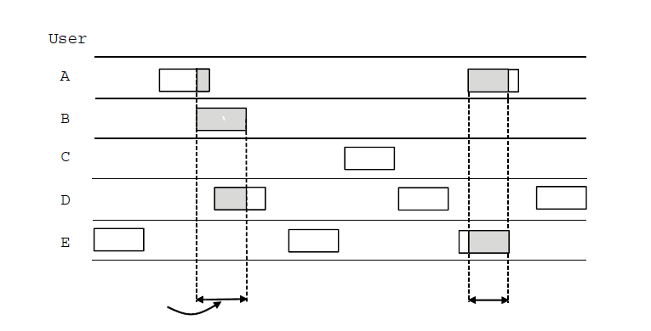
ALOHA
In pure ALOHA, users transmit frames whenever they have data
Users retry after a random amount of time for collisions
Efficient and low delay in low load environment
User
A
B
C
D
E
Collision
Time
Collision

Slide 10
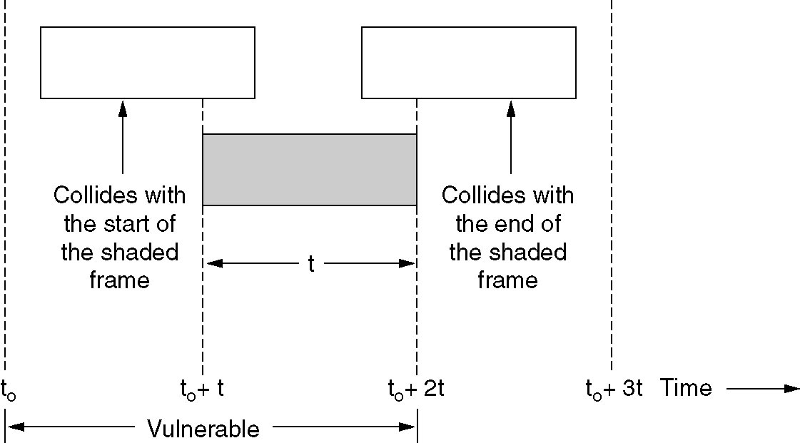
ALOHA (2)
Collisions happen when other users transmit during a vulnerable period that is twice the frame time
Synchronizing senders to slots can reduce collisions

Slide 11
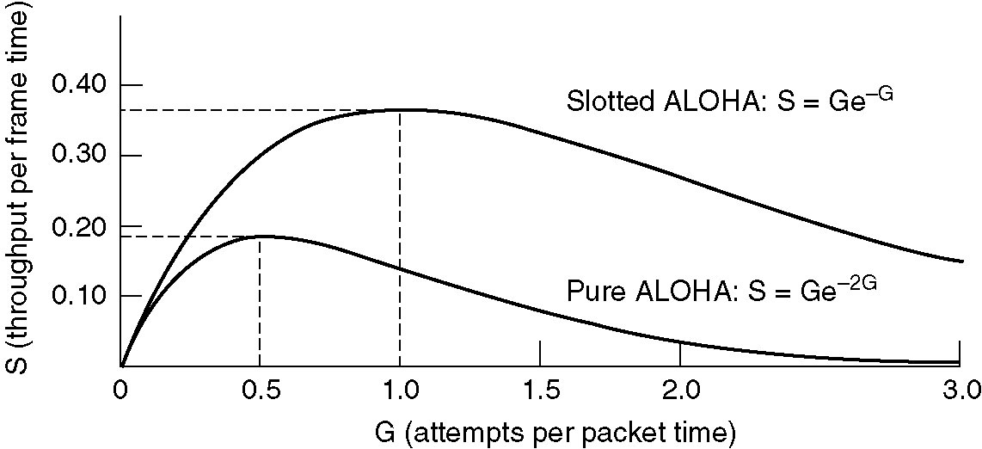
ALOHA (3)
Slotted ALOHA is twice as efficient as pure ALOHA
Low load wastes slots, high loads causes collisions
Efficiency up to 1/e (37%) for random traffic models

Slide 12
CSMA (Carrier Sense Multiple Access)
CSMA improves on ALOHA by sensing the channel
User doesn’t send if it senses someone else is sending
Variations on what to do if the channel is busy
1-persistent (greedy) sends as soon as the channel becomes idle
Non-persistent waits for a random amount of time before trying again
p-persistent sends with probability p when idle

Slide 13
CSMA (2)
1-persistent CSMA
If idle, transmit
If not idle, continuously sense until the channel becomes idle
Non-persistent CSMA
If idle, transmit
If not idle, wait for a random amount of time, then repeat the whole process

Slide 14
CSMA (3)
p-persistent CSMA
Applicable to slotted channels
If idle, transmit with probability p (and defer the transmission until the next slot with probability 1-p)
If not idle, wait for the next slot
If collision occurs, wait for a random amount of time

Slide 15
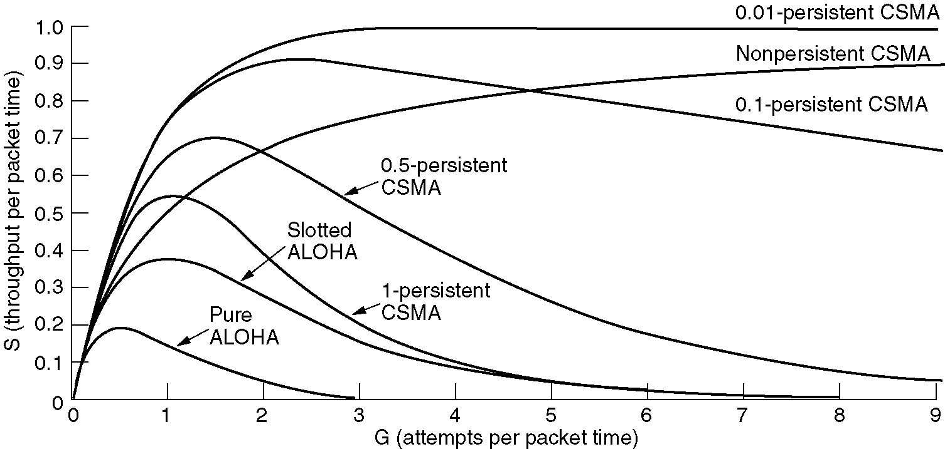
CSMA (4)
CSMA outperforms ALOHA
Being less persistent is better under high load

Slide 16
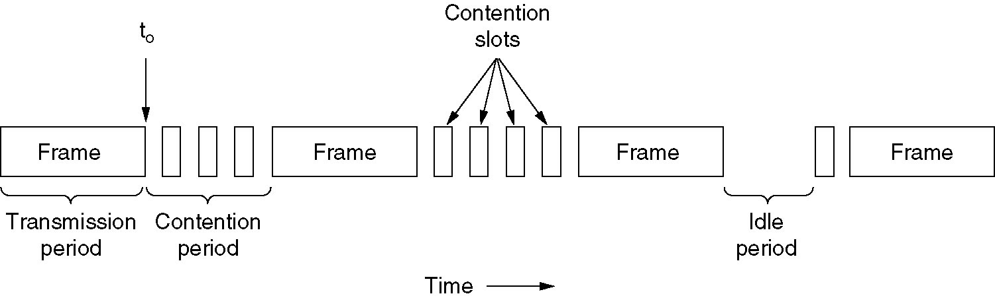
CSMA with Collision Detection
CSMA/CD improvement is due to aborting transmission upon detecting collision
Reduce contention time to improve performance
Collision time is much shorter than frame time

Slide 17
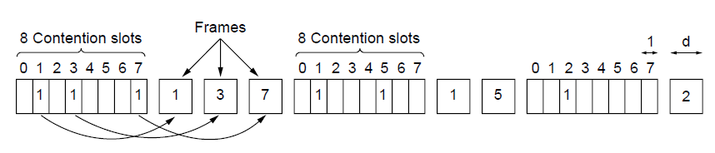
Collision-Free Protocols - Bitmap
Collision-free protocols avoid collisions completely
Sender must know when is its turn to send
The basic bit-map protocol
Sender sets a bit in contention slot if it has data
Senders send in turn
Everyone knows who has data to send

Slide 18
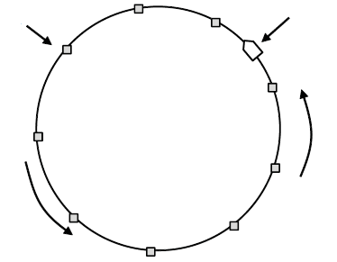
Collision-Free Protocols – Token Ring
Token sent round a ring determines the sending order
Station with token may send a frame before passing it
Idea can be used without ring too, e.g., token bus
Token
Station
Direction of
transmission

Slide 19
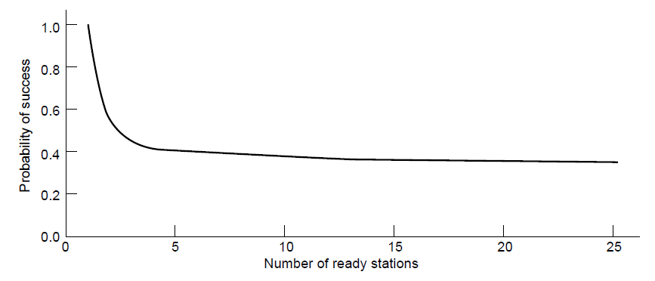
Limited-Contention Protocols
Divide stations into groups within which only a very small number are likely to send
Already too many contenders for a good chance of one winner

Slide 20
Wireless LAN Protocols
Wireless is more complicated compared to wired
Nodes may have different coverage regions
Lead to hidden and exposed nodes
Nodes cannot detect collisions, i.e., sense while sending
Makes collisions expensive and better to be avoided

Slide 21
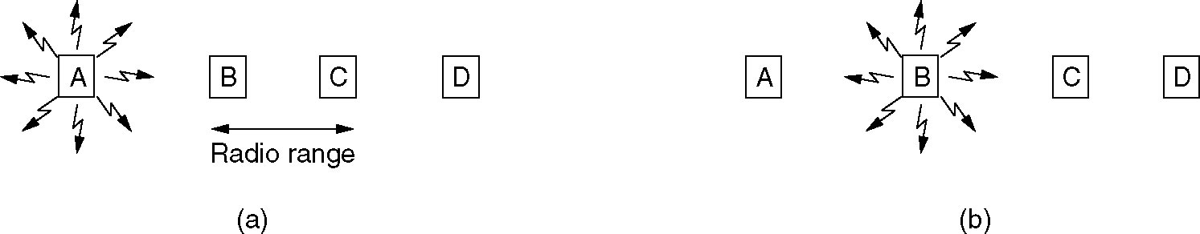
Wireless LAN Protocols (2)
A wireless LAN
(a) A is transmitting
(b) B is transmitting

Slide 22
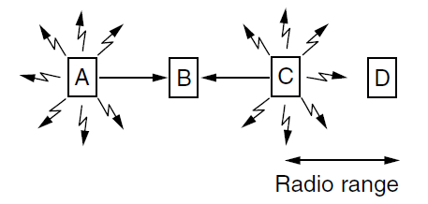
Wireless LAN Protocols – Hidden Nodes
Hidden nodes are senders that cannot sense each other but nonetheless collide at intended receiver
A and C are hidden nodes when sending to B
Consequence: loss of efficiency

Slide 23
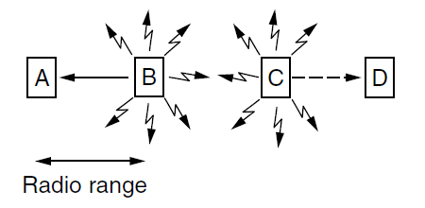
Wireless LAN Protocols – Exposed Nodes
Exposed nodes are senders who can sense each other but can still transmit safely (to different receivers)
B → A and C → D are exposed nodes
Desirable concurrency: improve performance

Slide 24
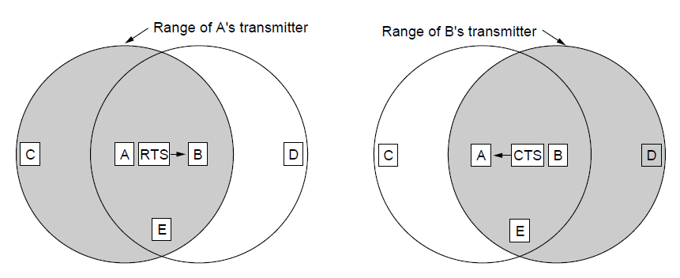
Wireless LAN Protocols - MACA
Multiple Access with Collision Avoidance protocol
A sends RTS to B [left]; B replies with CTS [right]
A sends RTS to B; C and E hear and defer for CTS
B replies with CTS; D and E hear and defer for data

Slide 25
Ethernet
Classic Ethernet
Switched/Fast Ethernet
Gigabit/10 Gigabit Ethernet

Slide 26
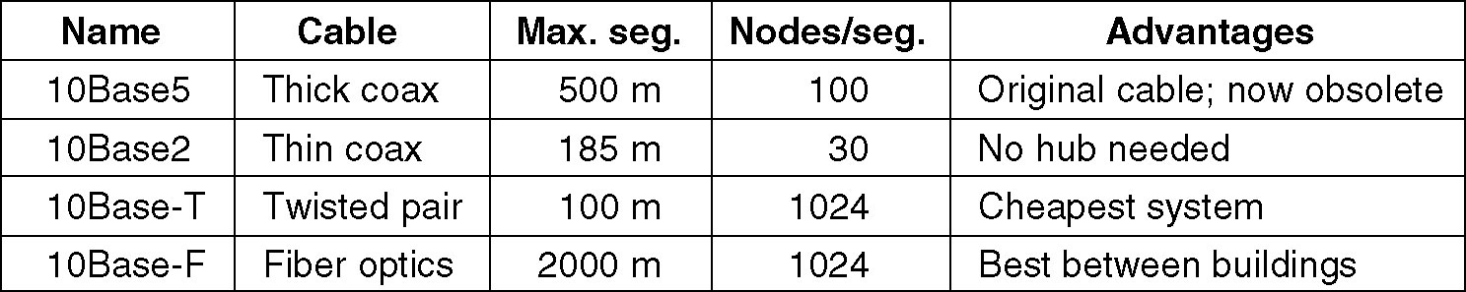
Ethernet Cabling
The most common kinds of Ethernet cabling

Slide 27
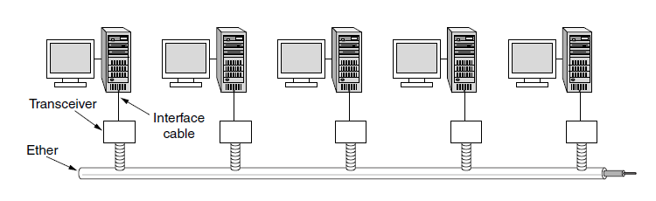
Classic Ethernet – Physical Layer
One shared coaxial cable to which all hosts attached
Up to 10 Mbps, with Manchester encoding
Hosts ran the classic Ethernet protocol for access

Slide 28
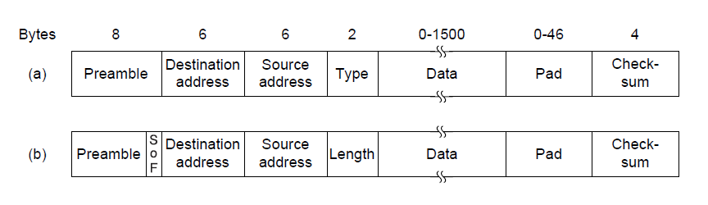
Classic Ethernet – MAC
MAC protocol is 1-persistent CSMA/CD (earlier)
Random delay (backoff) is computed with BEB (Binary Exponential Backoff) after collision
Frame format is still used in modern Ethernet
Ethernet
(DIX)
IEEE 802.3

Slide 29
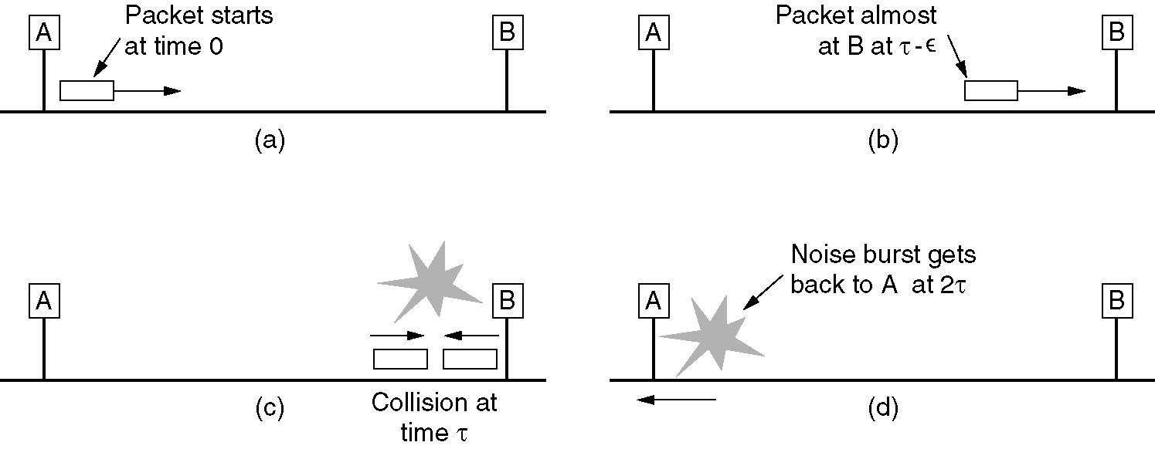
Classic Ethernet - MAC (2)
CSMA/CD
Collisions can occur and take as long as 2τ to detect
τ is the time it takes to propagate over the Ethernet
Leads to minimum packet size for reliable detection

Slide 30
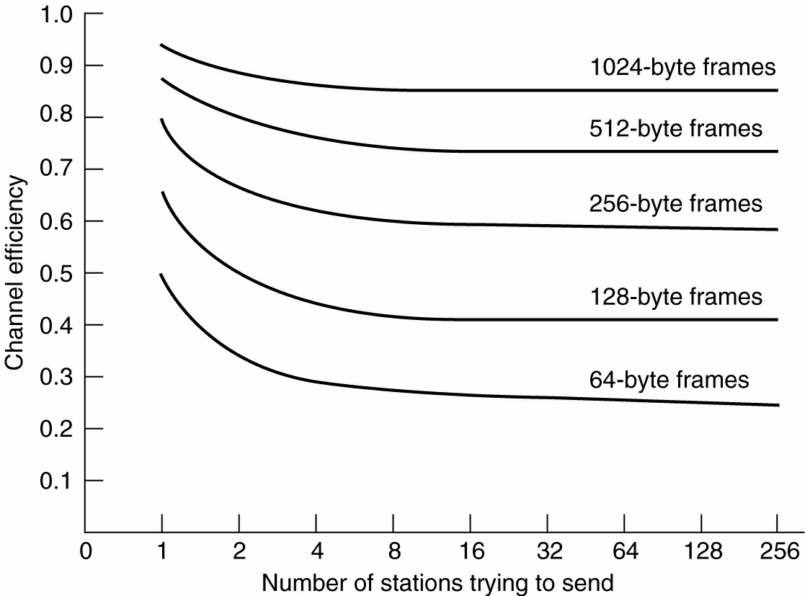
Classic Ethernet - Performance
Efficient for large frames, even with many senders
Degrades for small frames (and long LANs)

Slide 31
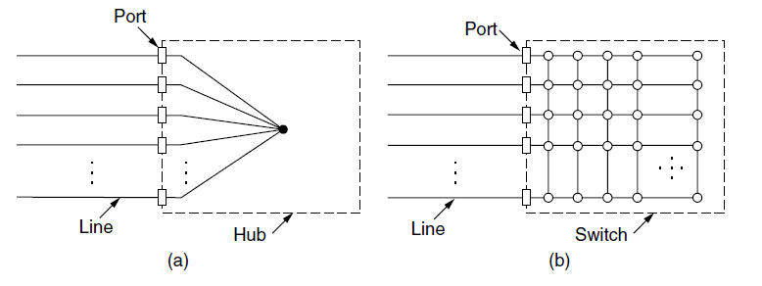
Switched/Fast Ethernet
Hubs join all lines to form a single CSMA/CD domain
Switches isolate ports to form separate domains
Much greater throughput for multiple ports
No need for CSMA/CD with full-duplex lines
November 4, 2017
Copyright @ Jingsha He 2004-2015
31

Slide 32
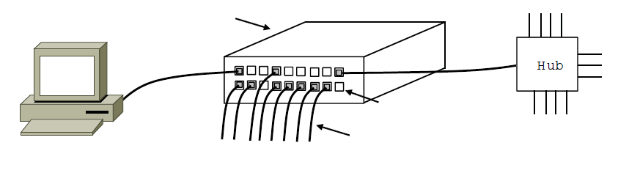
Switched/Fast Ethernet (2)
Switches be wired to computers, hubs and switches
Hubs concentrate traffic from computers
Switch
Hub
Switch ports
Twisted pair

Slide 33
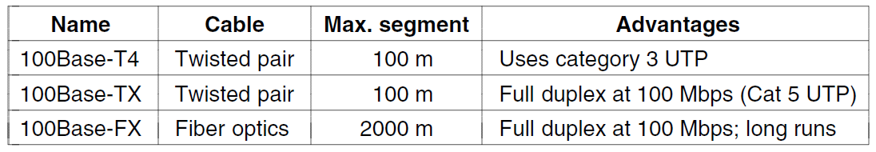
Switched/Fast Ethernet (3)
Fast Ethernet extends Ethernet from 10Mbps to 100 Mbps
Twisted pair (with Cat 5) has dominated the market

Slide 34
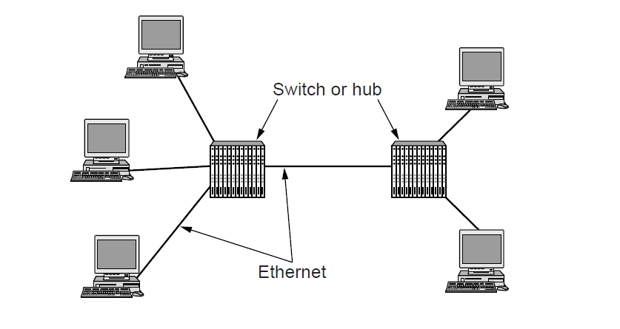
Gigabit / 10 Gigabit Ethernet
Switched Gigabit Ethernet has become the mainstream
With full-duplex lines between computers/switches

Slide 35
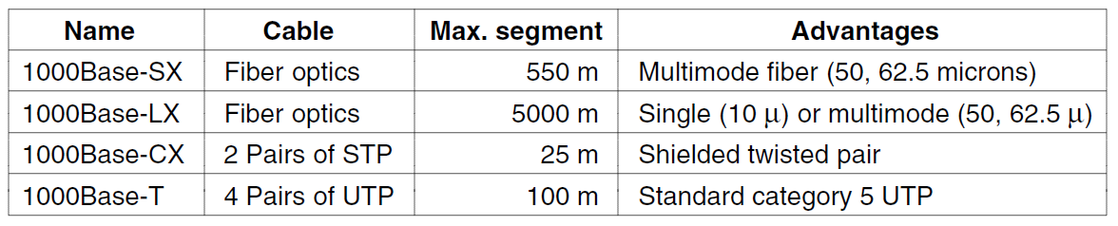
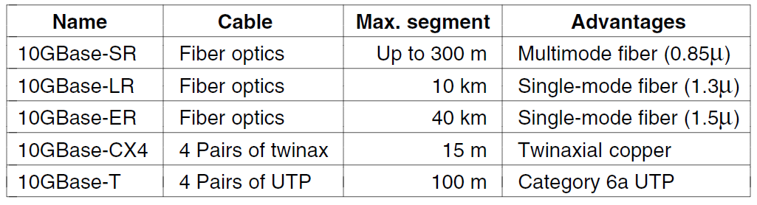
Gigabit / 10 Gigabit Ethernet (2)
Gigabit Ethernet is commonly run over twisted pair
10 Gigabit Ethernet is being deployed where needed
40/100 Gigabit Ethernet is under development

Slide 36
Wireless LANs
802.11 architecture/protocol stack
802.11 physical layer
802.11 MAC
802.11 frames
November 4, 2017
Copyright @ Jingsha He 2004-2015
36

Slide 37
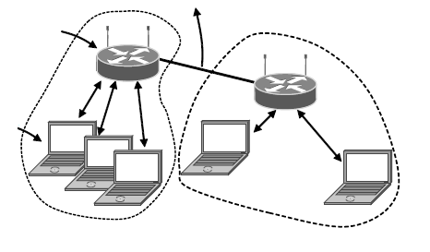
802.11 Architecture/Protocol Stack
To Network
Access Point
Client
November 4, 2017
Copyright @ Jingsha He 2004-2015
37
Wireless clients associate to a wired access point (AP)
Called infrastructure mode
Without an AP: called ad-hoc mode, but that is the future

Slide 38
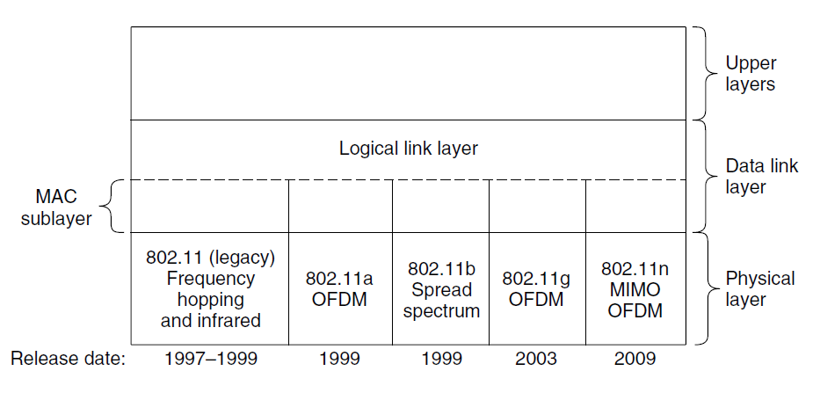
802.11 Architecture/Protocol Stack (2)
November 4, 2017
Copyright @ Jingsha He 2004-2015
38
MAC is used across different physical layers

Slide 39
802.11 Physical Layer
Name | Technique | Max. Bit Rate
802.11b | Spread spectrum, 2.4 GHz | 11 Mbps
802.11g | OFDM, 2.4 GHz | 54 Mbps
802.11a | OFDM, 5 GHz | 54 Mbps
802.11n | OFDM with MIMO, 2.4/5 GHz | 600 Mbps
November 4, 2017
Copyright @ Jingsha He 2004-2015
39
NICs are compatible with multiple physical layers, e.g., 802.11 a/b/g

Slide 40
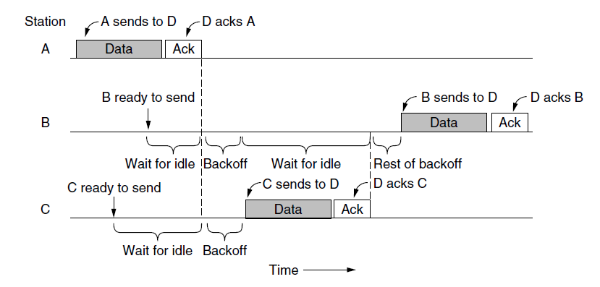
802.11 MAC
November 4, 2017
Copyright @ Jingsha He 2004-2015
40
CSMA/CA inserts backoff slots to avoid collisions
MAC uses ACKs/retransmissions for wireless errors

Slide 41
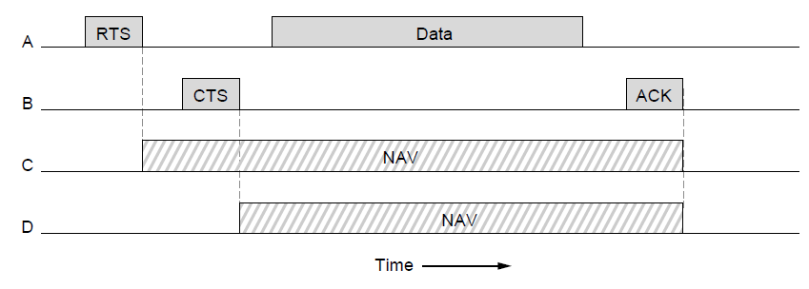
802.11 MAC (2)
November 4, 2017
Copyright @ Jingsha He 2004-2015
41
Virtual channel sensing with the NAV (network allocation vector) and optional RTS/CTS (often not used) avoids hidden terminals

Slide 42
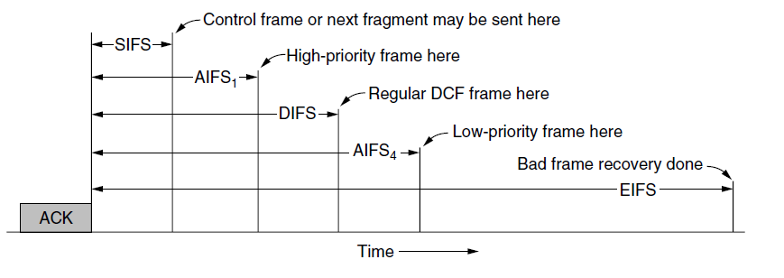
802.11 MAC (3)
November 4, 2017
Copyright @ Jingsha He 2004-2015
42
Different backoff slot times support quality of service
Short intervals are given to preferred access, e.g., control, VoIP
MAC also has other mechanisms, e.g., power save

Slide 43
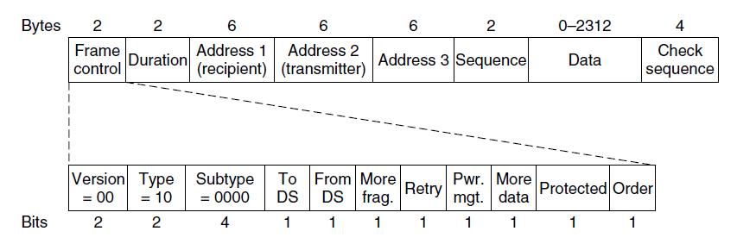
802.11 Frames
November 4, 2017
Copyright @ Jingsha He 2004-2015
43
Frames have different types specified by “Frame control”
Data frames have 3 addresses to pass via APs

Slide 44
Broadband Wireless
802.16 architecture/protocol stack
802.16 physical layer
802.16 MAC
802.16 frames

Slide 45
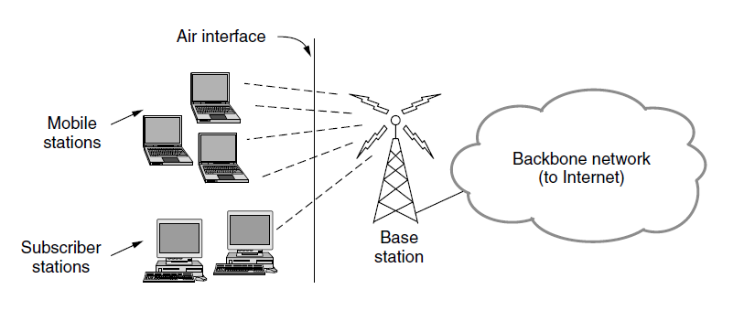
802.16 Architecture/Protocol Stack
Wireless clients connect to a wired base station (like 3G)

Slide 46
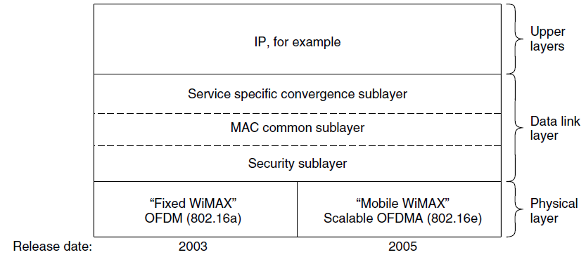
802.16 Architecture/Protocol Stack (2)
MAC is connection-oriented
IP is connectionless
Convergence sublayer maps between the two

Slide 47
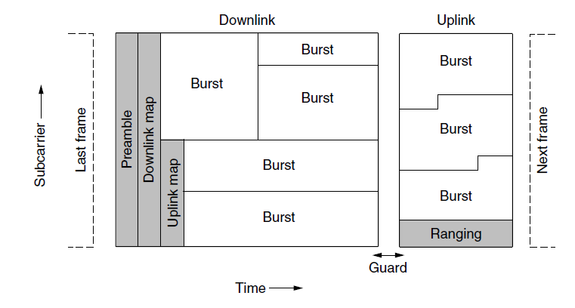
802.16 Physical Layer
Based on OFDM (Orthogonal Frequency Division Multiplexing)
Base station gives mobile terminals bursts (subcarrier/time frame slots) for uplink and downlink

Slide 48
802.16 MAC
November 4, 2017
Copyright @ Jingsha He 2004-2015
48
Connection-oriented with base station in control
Clients request the bandwidth in need
Different kinds of service can be requested
Constant bit rate, e.g., uncompressed voice
Real-time variable bit rate, e.g., video, Web
Non-real-time variable bit rate, e.g., file download
Best-effort for everything else

Slide 49
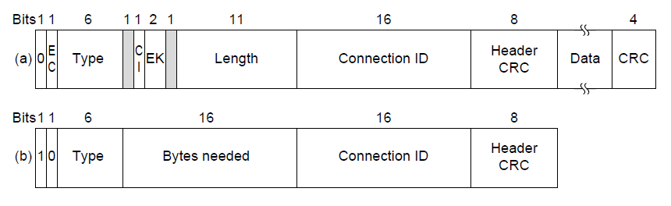
802.16 Frames
(a)
(b)
(a) A generic frame. (b) A bandwidth request frame
November 4, 2017
Copyright @ Jingsha He 2004-2015
49
Frames vary depending on their type
Connection ID instead of source/destination addresses

Slide 50
Bluetooth
Bluetooth architecture
Bluetooth applications/protocol
Bluetooth radio/link layers
Bluetooth frames

Slide 51
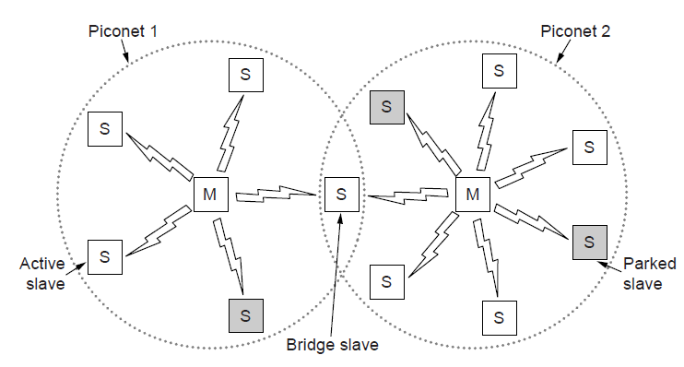
Bluetooth Architecture
Piconet master is connected to slave wireless devices
Slaves may go into sleep (parked) to save power
Two piconets can be bridged into a scatternet

Slide 52
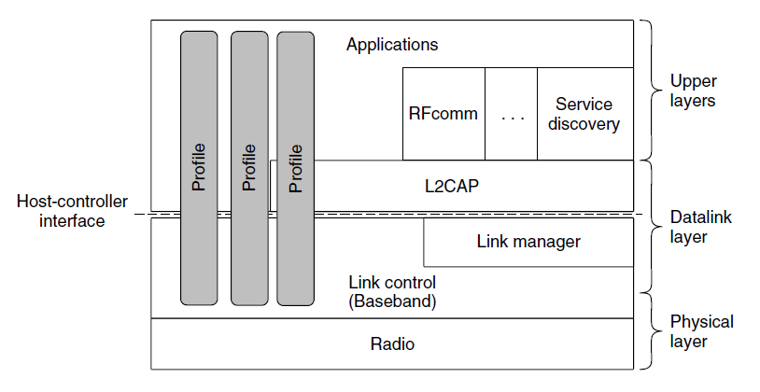
Bluetooth Applications/Protocol Stack
Profiles give the set of protocols for a given application
25 profiles in total: headset, intercom, streaming audio, remote control, personal area network, etc.

Slide 53
Bluetooth Radio/Link Layers
Radio layer
Uses adaptive frequency hopping in 2.4 GHz band
Link layer
TDM with timeslots for master and slaves
SCO (synchronous connection oriented) for periodic slots in each direction
ACL (asynchronous connectionless) for packet-switched data
Links undergo pairing (user confirms passkey/PIN) to authorize the user before use

Slide 54
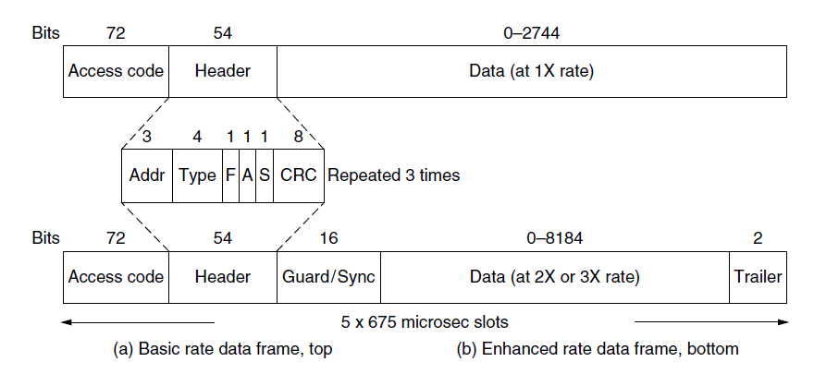
Bluetooth Frames
Time is slotted
Enhanced data rates send faster but for the same time
Addresses are only 3 bits (for 8 devices)
(a)
(b)
(a)
(b)

Slide 55
RFID *
EPC Gen 2 architecture
EPC Gen 2 physical layer
EPC Gen 2 Tag Identification layer
EPC Gen 2 frames

Slide 56
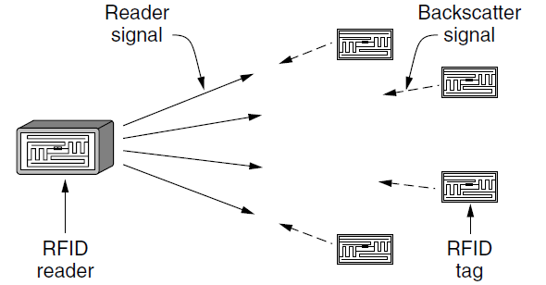
EPC Gen 2 Architecture
Reader signal powers tags
Tags reply with backscatter

Slide 57
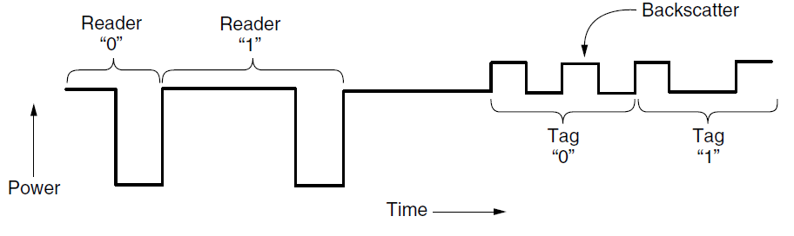
EPC Gen 2 Physical Layer
Reader uses duration of on period to send 0/1
Tag backscatters reader signal in pulses to send 0/1

Slide 58
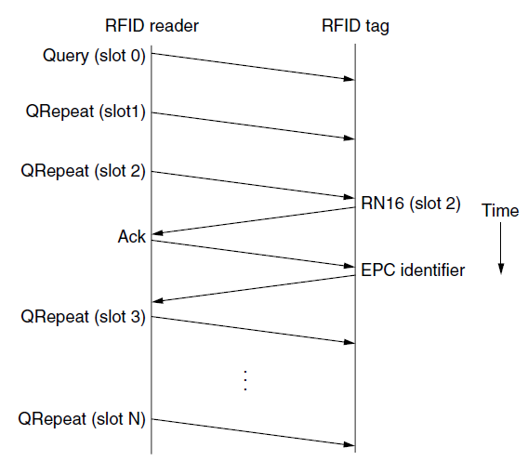
EPC Gen 2 Tag Identification Layer
Reader sends query and sets slot structure
Tags reply (RN16) in a random slot (may collide)
Reader asks one tag for its identifier (Ack)
Process continues until no tags are left

Slide 59
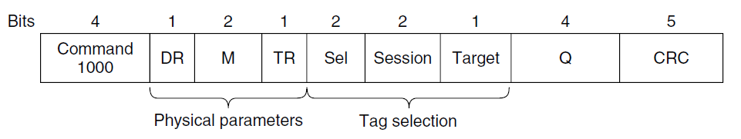
EPC Gen 2 Frames
Reader frames vary based on type (Command)
Query shown below with parameters and error detection
Tag responses are simply data
Reader sets timing and knows the expected format

Slide 60
Data Link Layer Switching
Uses of bridges
Learning bridges
Spanning tree
Repeaters, hubs, bridges, routers and gateways
Virtual LANs

Slide 61
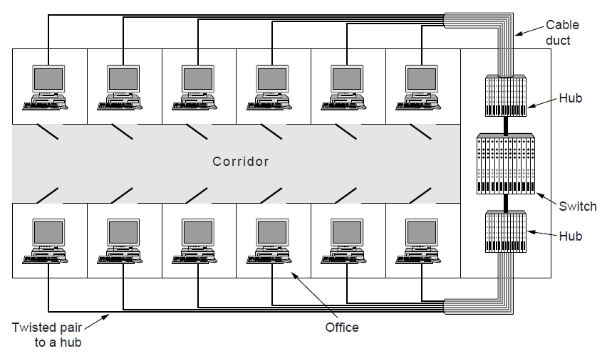
Uses of Bridges
Common setup is a building with centralized wiring
Bridges (switches) are placed in or near wiring closets

Slide 62
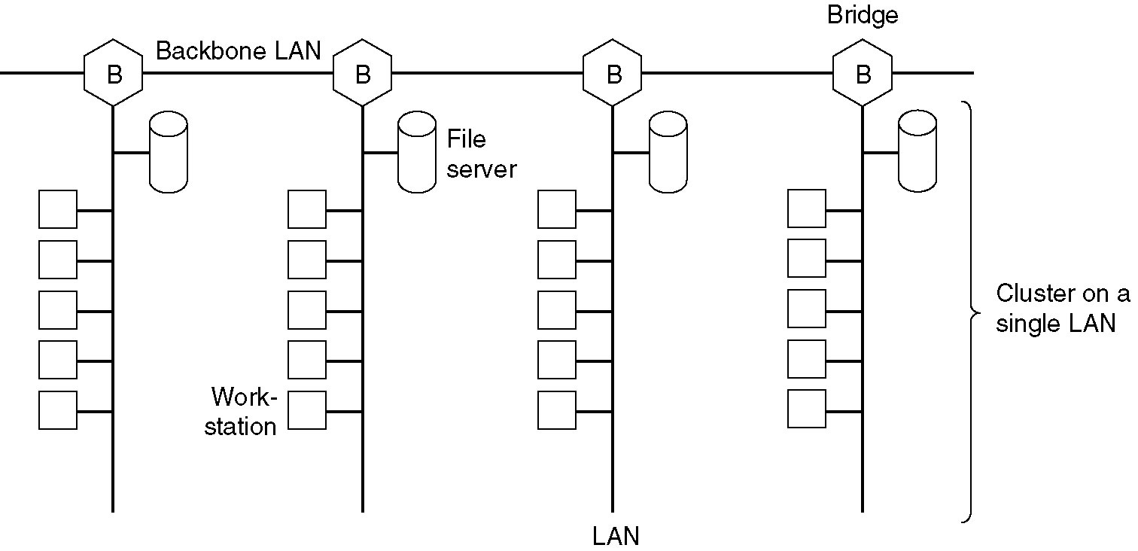
Uses of Bridges (2)
Multiple LANs can be connected by bridges to handle load that is higher than the capacity of a single LAN

Slide 63
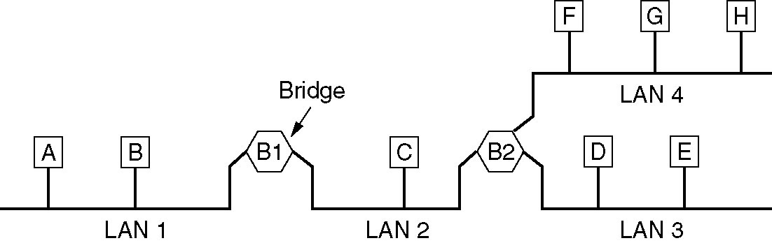
Uses of Bridges (3)
A configuration with four LANs and two bridges

Slide 64
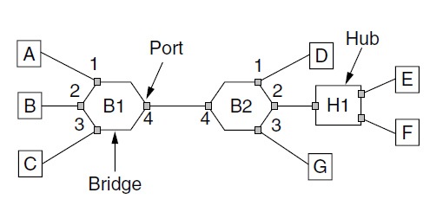
Learning Bridges
A bridge can be operated as a switched LAN (not a hub)
Computers, bridges and hubs connect to its ports

Slide 65
Learning Bridges (2)
Backward learning algorithm picks the output port
Source address in a frame is associated with the input port
Frame with destination address is sent to the learned port
Frame with an unlearned destination is sent to all ports except the input port
Frame is discarded if destination port is the same as the source port
No need for configuration
Forget unused addresses to allow changes
Bandwidth efficient for two-way traffic

Slide 66
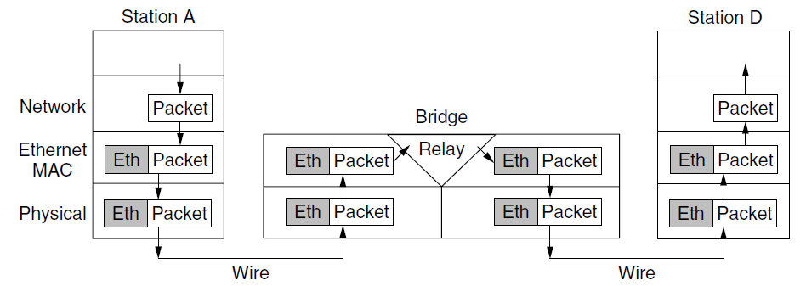
Learning Bridges (3)
Bridges extend the data link layer
Use but don’t remove Ethernet header/addresses
Don’t inspect the network header

Slide 67
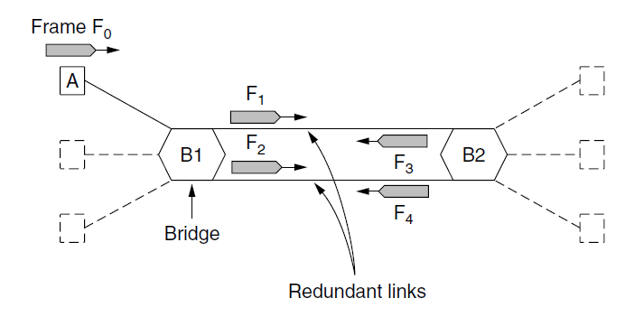
Spanning Tree
Problem
Bridge topologies may contain loops
Backward learning may cause frames to circulate for ever
Spanning tree support is needed to solve the problem

Slide 68
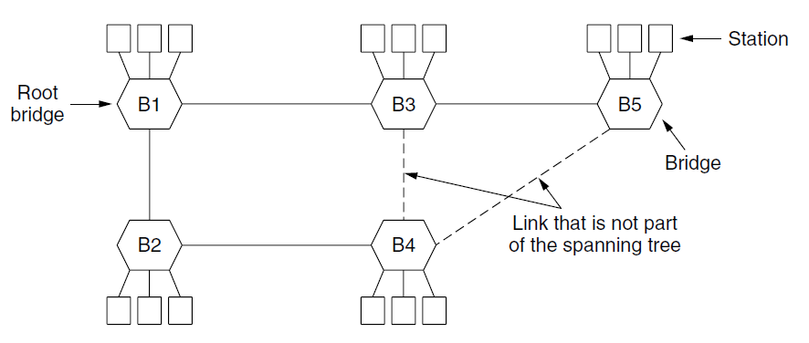
Spanning Tree (2)
Only a subset of the forwarding ports is used for data to avoid loops
The subset can be selected using a spanning tree distributed algorithm

Slide 69
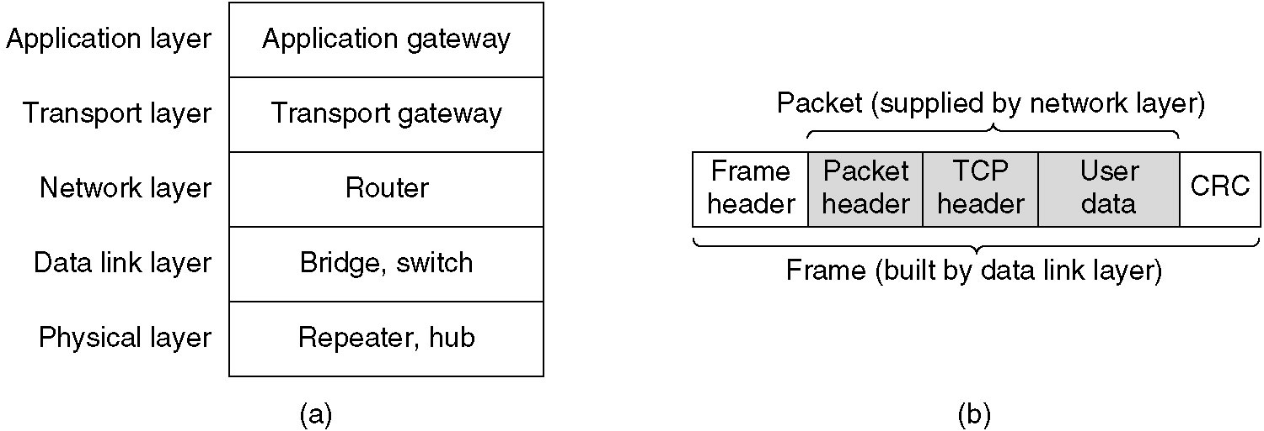

Repeaters, Hubs, Bridges, Switches, Routers and Gateways
Devices are named according to the layer they work
Bridge and switch operate in the data link layer
(a) Which device is in which layer
(b) Frames, packets and headers

Slide 70
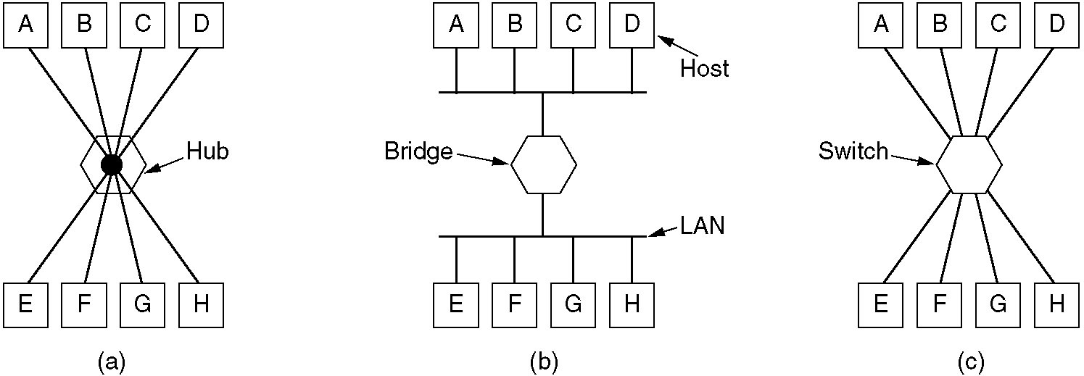
Repeaters, Hubs, Bridges, Switches, Routers and Gateways (2)
(a) Hub
(b) Bridge
(c) Switch

Slide 71
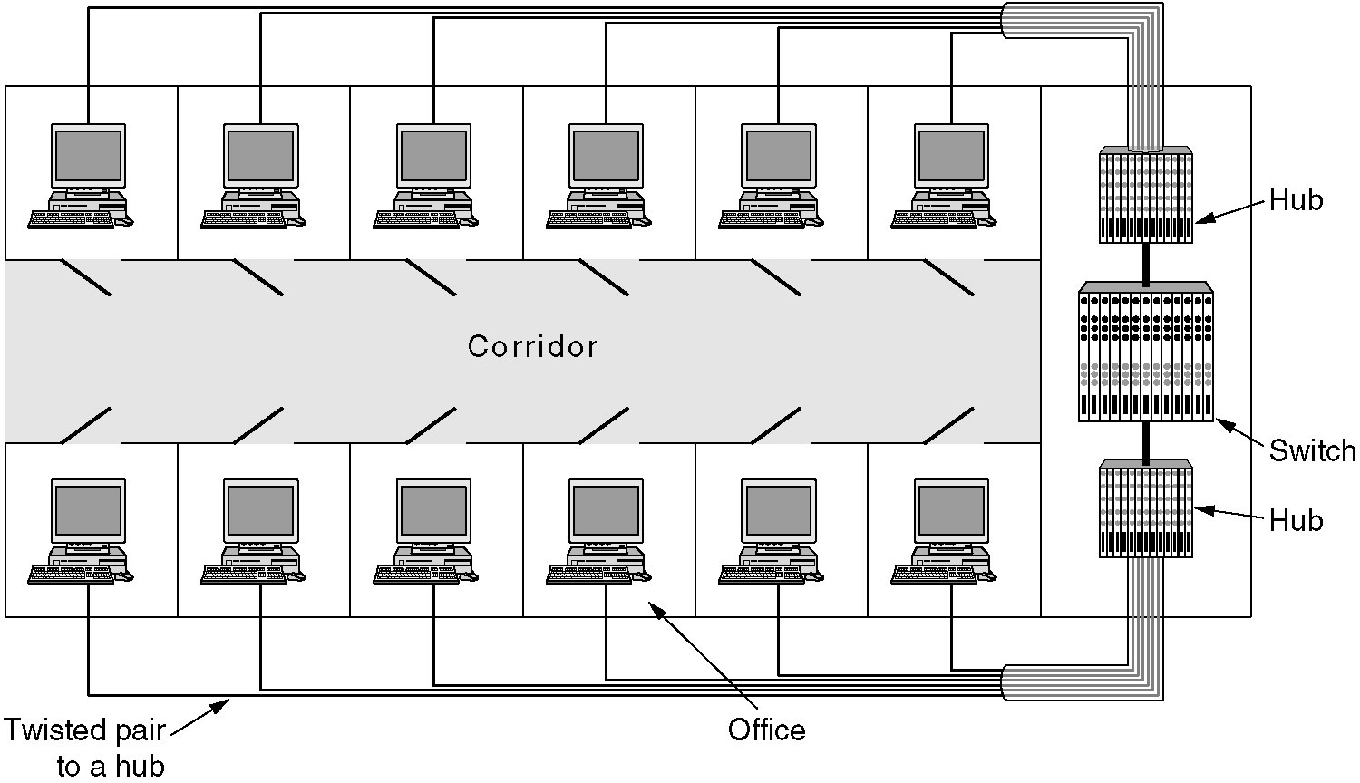
Virtual LANs
A building with centralized wiring using hubs and a switch

Slide 72

Virtual LANs (2)
VLANs (Virtual LANs) split one physical LAN into multiple logical LANs to ease management tasks
Ports are assigned to the VLAN that they belong

Slide 73

Virtual LANs (3)
Four physical LANs can be organized into two VLANs (gray and white) by two bridges, as in (a)
The same 15 machines can also be organized into two VLANs by switches, as in (b)

Slide 74

Virtual LANs - IEEE 802.1Q
Bridges need to be aware of VLANs to support them
In 802.1Q, frames contain a VLAN tag
Legacy switches with no tags are also supported

Slide 75

Virtual LANs - IEEE 802.1Q (2)
802.1Q frames carry a tag (VLAN identifier)
Length/Type value is 0x8100 for VLAN protocol

Slide 76
Q & A

